Slide 1
We have learned …
Symmetric encryption: DES, 3DES, AES, RC4
Public-key encryption: RSA
Hash: SHA-1
MAC: CBC-MAC, CMAC, HMAC
Digital signature: RSA
Entity authentication: challenge and response
Key agreement: Diffie-Hellman, RSA
Certicificate

Slide 2
SSL-Secure Socket Layer

Slide 3
Services Provided by SSL
SSL encrypts data so that no one who intercepts is able to read it.
SSL can assure a client that they are dealing with the real server they intended to connect to.
SSL can prevent any unauthorized clients from connecting to the server.

Slide 4
Services Provided by SSL
These capabilities address fundamental concerns about communication over the Internet and other TCP/IP networks:
SSL server authentication
SSL client authentication
An encrypted SSL connection

Slide 5
An encrypted SSL connection
An encrypted SSL connection requires all information sent between a client and a server to be encrypted by the sending software and decrypted by the receiving software, thus providing a high degree of confidentiality.
Confidentiality is important for both parties to any private transaction.
In addition, all data sent over an encrypted SSL connection is protected with a mechanism for detecting tampering--that is, for automatically determining whether the data has been altered in transit.

Slide 6
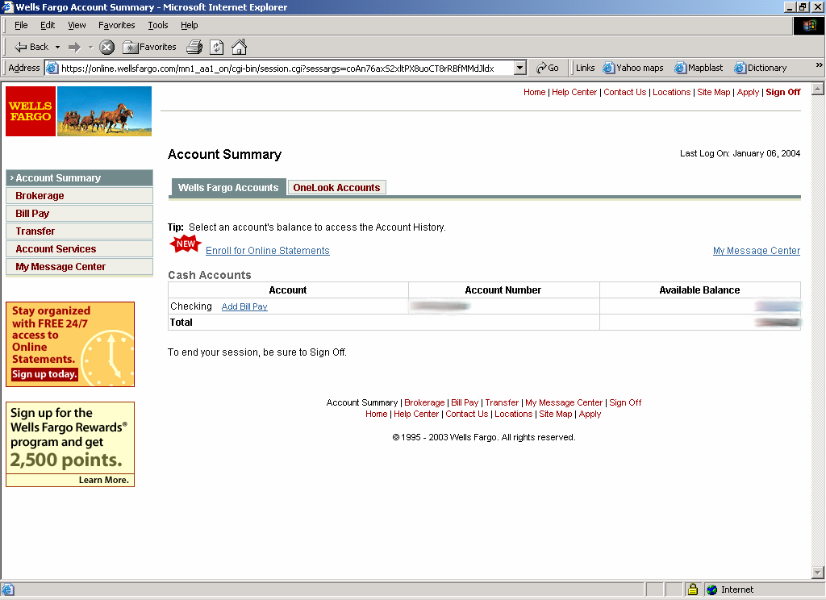
SSL in the Real World

Slide 7
SSL (Secure Socket Layer)
TCP: provides a reliable end-to-end service.
TCP & SSL: provides a reliable & secure end-to-end service.
HTTPS: HTTP over SSL (or TLS)
  Typically on port 443 (regular http on port 80)
SSL originally developed by Netscape
subsequently became Internet standard known as TLS (Transport Layer Security)
SSL has two layers of protocols

Slide 8
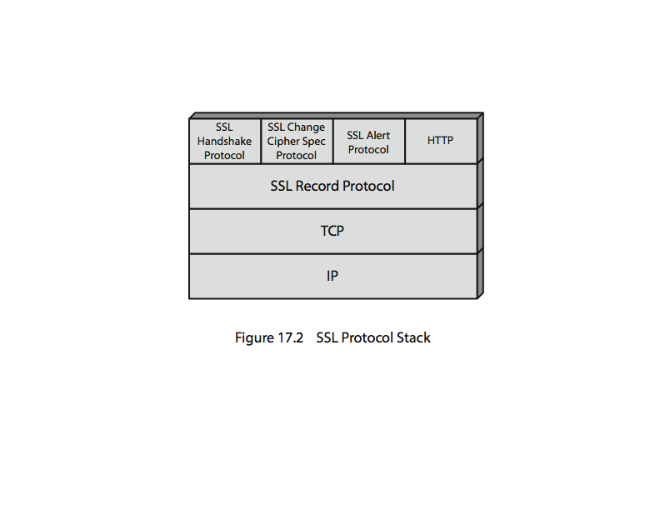
SSL Architecture
SSL between Transmission Control Protocol (TCP) layer and Application layer

Slide 9
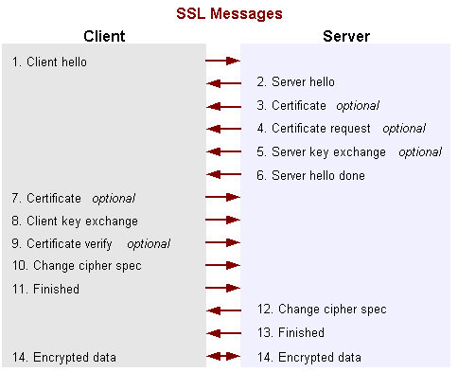
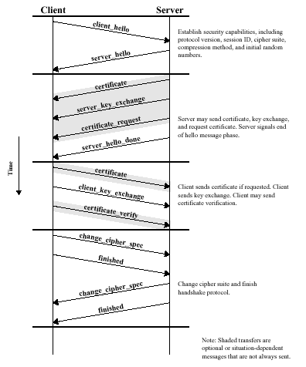
SSL Handshake (1)

Slide 10
SSL Handshake (1)
Client hello - The client sends the server information including the highest version of SSL it supports and a list of the cipher suites it supports.
Server hello - The server chooses the highest version of SSL and the best cipher suite that both the client and server support and sends this information to the client.
Certificate - If server authentication is required then the server sends the client a certificate or a certificate chain.
Certificate request - If the server needs to authenticate the client, it sends the client a certificate request.
Server key exchange - The server sends the client a server key exchange message when the public key information sent in 3) above is not sufficient for key exchange.
Server hello done - The server tells the client it is finished with its initial negotiation messages.

Slide 11
SSL Handshake (1)
Certificate - If the server requests a certificate from the client in Message 4, the client sends its certificate chain, like the server did in Message 3.
Client key exchange - The client generates information used to create a key to use for symmetric encryption. For RSA, the client then encrypts this key information with the server's public key and sends it to the server.
Certificate verify – If the server is authenticating the client, the client sends a random number that it digitally signs. When the server decrypts number with the client's public key, the server authenticates the client.
Change cipher spec - The client tells the server to change to encrypted mode.
Finished - The client sends the server a hash of the handshake messages.
Change cipher spec - The server tells the client to change to encrypted mode.
Finished - The server sends the client a hash of the handshake messages.
Encrypted data - The client and the server communicate using the symmetric encryption algorithm and the cryptographic hash function negotiated in Messages 1 and 2, using the secret key that the client sent to the server in Message 8.

Slide 12
Participants as Finite-State Machines
Mur rules define a finite-state machine for each protocol participant
Client state
Server state
ClientHello
M_SLEEP
M_CLIENT_HELLO
ServerHello
M_SERVER_HELLO
M_SEND_KEY
ServerKeyExchange
M_SERVER_KEY
M_CLIENT_KEY
M_SEND_KEY
M_DONE
ClientKeyExchange

Slide 13
Handshake Protocol Structure
ClientHello
S
C
[Certificate],
ClientKeyExchange,
[CertificateVerify]
ServerHello,
[Certificate],
[ServerKeyExchange],
[CertificateRequest],
ServerHelloDone
switch to negotiated cipher
Finished
switch to negotiated cipher
Finished

Slide 14
ChangeCipherSpec Protocol (2)
Special protocol with only one message
When Client processes encryption information, it sends ChangeCipherSpec message
  Signals all following messages will be encrypted
ChangeCipherSpec is always followed by Finished message

Slide 15
The End of the Beginning
Upon receipt of ChangeCipherSpec, Server sends its own ChangeCipherSpec and Finished messages
After both Client and Server receive Finish messages, Handshaking phase is over
All following communication is encrypted
Encryption and compression methods can be changed with new ChangeCipherSpec messages

Slide 16
Alert Protocols (3)
Alert protocol always two byte message
  First byte indicates severity of message
    Warning or Fatal
    A Fatal alert will terminate the connection
  Second byte indicate preset error code
  Secure connection end alert not always used

Slide 17
SSL Record Protocol (4)
SSL Record Protocol provides two services.
Message integrity
  using a MAC with a shared secret key
  similar to HMAC but with different padding
  hash functions: MD5, SHA-1
Message confidentiality
  using symmetric encryption with a shared secret key
  Encryption algorithms: AES, IDEA, RC2-40, DES-40, DES, 3DES, RC4-40, RC4-128

Slide 18
SSL Record Protocol (4)
The SSL record protocol defines the format used to transmit data
The SSL record protocols provides two services for SSL connections:
  Confidentiality: The Handshake Protocol defines a shared secret key that is used for conventional encryption of SSL payloads
  Message Integrity: The Handshake Protocol also defines a shared secret key that is used to form a message authentication code (MAC)

Slide 19
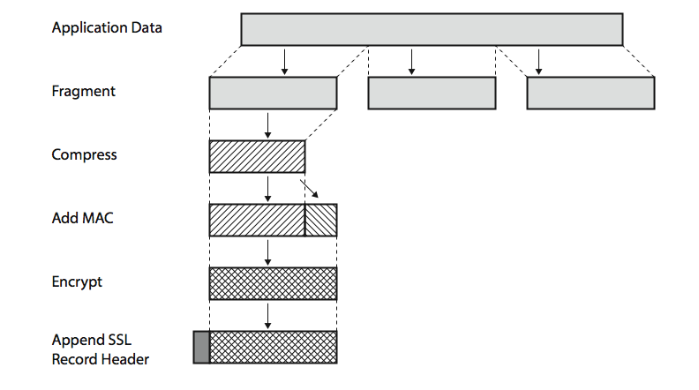
SSL Record Protocol Operation
≤ 2¹⁴ bytes
(optional; default: null)

Slide 20
Record Layer
Frames and encrypts upper level data into one protocol for transport through TCP
5 byte frame
  1st byte protocol indicator
  2nd byte is major version of SSL
  3rd byte is minor version of SSL
  Last two bytes indicate length of data inside frame, up to 2¹⁴
Message Authentication Code (MAC)

